Slide 1
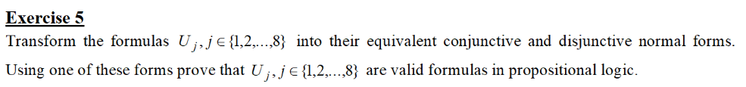

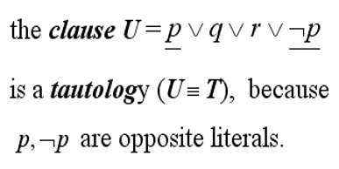


2
3
1
4
$U_{2}$ = (p → q) /\ (p /\ q → r) → (p → r) (apply U → V ≡ ¬U \/ V)
If we apply distributivity with U = (p \/ r), V = (p \/ ¬p) and Z = (¬q \/ ¬p), then:
≡ ¬((¬p \/ q) /\ ¬(p /\ q) \/ r) \/ ¬p \/ r (apply De Morgan’s Law)
≡ (p /\ ¬q) \/ (p /\ q /\ ¬r) \/ ¬p \/ r (negate p /\ ¬r)
≡ (p \/ ¬p) /\ (¬q \/ ¬p) \/ (p \/ r) /\
(q \/ r) /\ (¬r \/ r)
≡ (p /\ ¬q) \/ (¬p \/ r) /\ q \/ ¬p \/ r (apply distributivity over
the second parantheses and the q)
≡ (p \/ ¬p \/ p \/ r) /\ (¬q \/ ¬p \/ p \/ r)
/\ (q \/ r) /\ (¬r \/ r)
DNF
≡ (p /\ ¬q) \/ (¬p /\ q) \/ (r /\ q) \/ ¬p \/ r
,which is the CNF of $U_{2}$.
Acum ca am rezolvat exercitiul la seminar, inteleg
cum aceasta abordare e gresita, dar tot am zis sa uploadez asa.
These two are opposites
in a clause, so according to:
, $U_{2}$ is valid (tautology).

